Slide 1

Diversity and Inclusion Exercise – Sharing My Story
Purpose:
The purpose of this Diversity and Inclusion exercise “Sharing My Story” is to provide a structured way for Red Crossers to get to know one another and gain experience in talking about what makes them diverse in the form of storytelling.
Exercise Objective:
For participants to learn more about the people they work with and to gain experience in identifying what makes them and their team mates diverse.
Take the Lead:
This exercise is best when initiated by the teams’ leader. Leaders will “model” how to tell a story that is focused on what makes them diverse. To do this, we recommend preparing your story in advance.
Start by reviewing the D&I wheel (Slide 2) and select as many life categories that you can find details to share about. Be specific in your sharing and if possible, connect how that diverse detail about you might be helpful to the work we do as an organization. For example, explain how your experience growing up in the city and “social status” that you did might be helpful to the work we do in blood collection in that area. Use the PPT template (Slide 3) to put a visual together as you present your story to the team. Use the example (Slide 4) if you need further guidance, but don’t forget to remove it later.
Make the point that all sorts of things (well beyond color and gender) make us all diverse. To create an inclusive environment for our clients, partners and each other we must first be able to recognize things that make us different from one another. In doing so, we begin to recognize that all of us are in fact included in this discussion about diversity. Not only are we included in the discussion, we all share responsibility in making the place we work an inclusive environment.
The main exercise – instructions:
(Leader will partner people up before the exercise.)
With your partner, take 5 minutes each to introduce yourself to one another.
Include at least 3 specific things that make you diverse.
(Be prepared to introduce your partner to the room.)
Desired Outcome:
Red Crossers will begin sharing in the responsibility of creating an environment that is culturally competent, specifically one where there is thoughtfulness if cross cultural interaction.

Slide 2
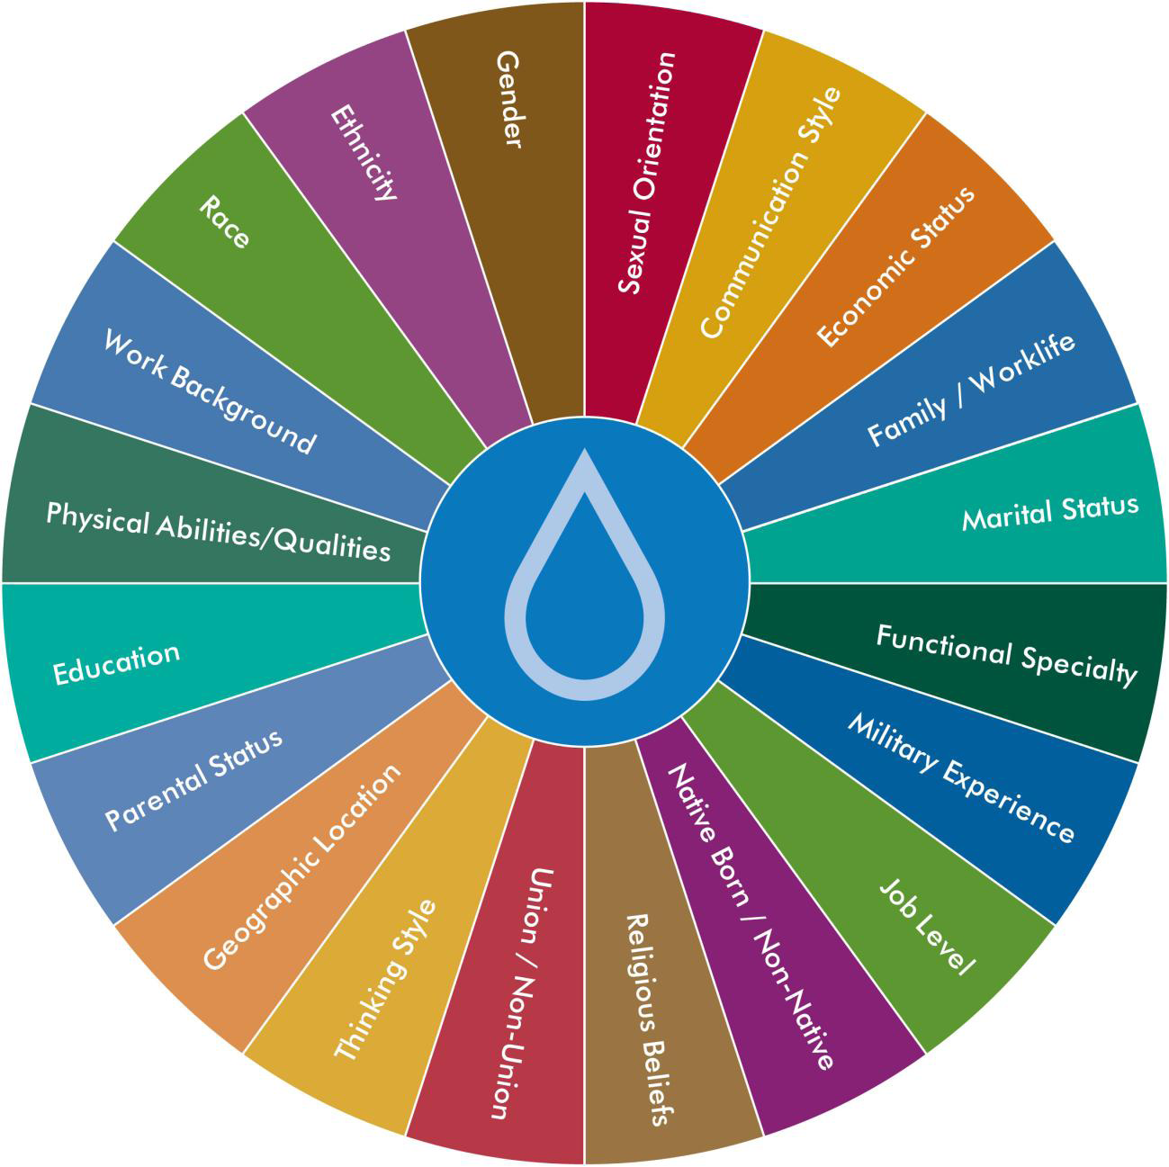

Diversity & Inclusion Wheel

Slide 3
INSERT
IMAGE
HERE
What makes me diverse?
Insert point here
Insert point here
Insert point here
Insert point here
And so on … as needed.

Slide 4
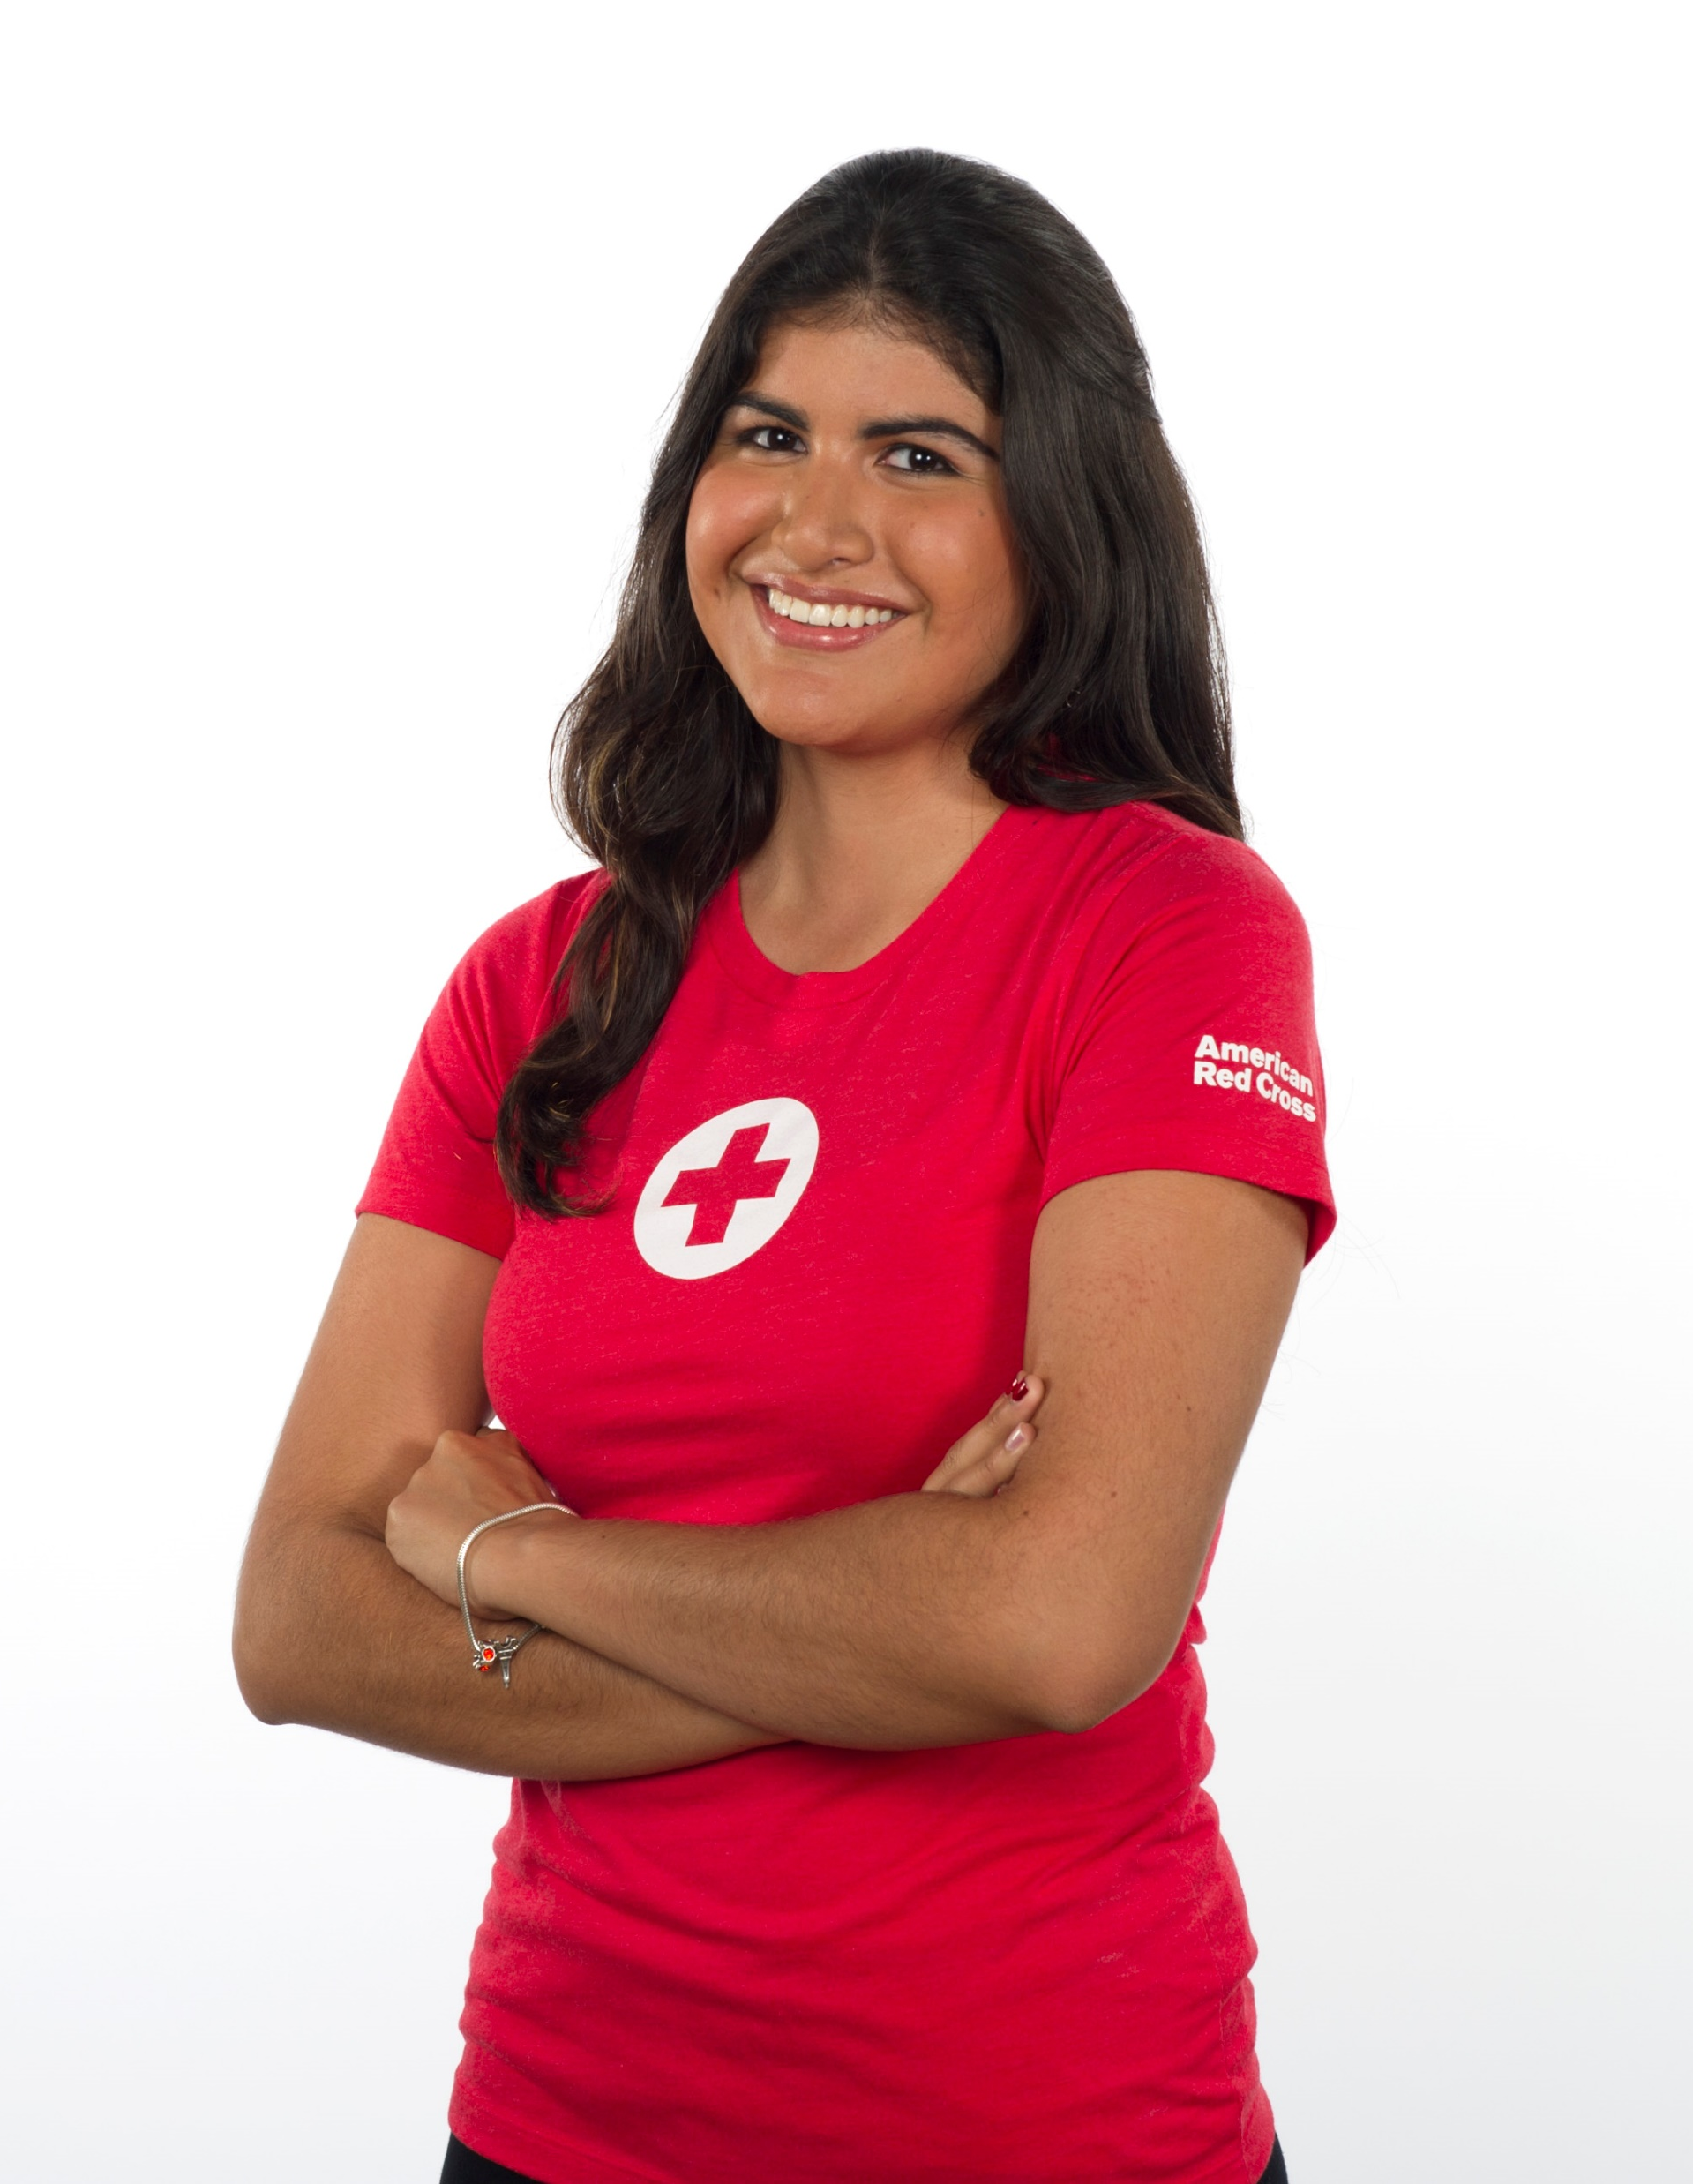
What makes me diverse?
Born and raised in Wisconsin
Introvert
First-Generation College Student
Thinking Style – I love lists!
Cis-gender Female – she/her/hers
Speak 2 Languages Fluently – English and Russian
EXAMPLE

