Slide 1
Engaging Young Professionals

Slide 2
Agenda
Introductions
Activity: Defining the Young Professional
Making the Case
Starting your Group
Resources
Questions!

Slide 3
Introductions
Bianca Kahlenberg
Pat West

Slide 4
Activity:
Defining the Young Professional

Slide 5
Defining the Young Professional
Think about a young professional(s) you know and what characteristics they have. List a few characteristics:
that would make them a great young professional representative of the Red Cross
that might be a threat (i.e. stressful job, kids, grad school etc).
*
Notes:
Ask each table or pair to share one positive characteristic and one potential threat (aggregate a list)
How well do you know young professionals?
- Share some data from Research done on Young Professionals group (BK can pull this from the information and work being done with Nathan on Young Humanitarian program)
*

Slide 6
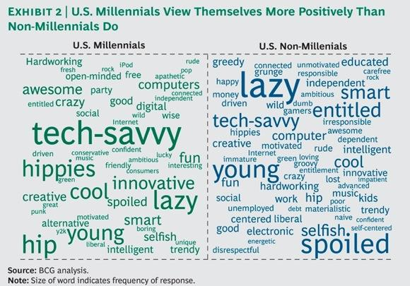
Young Professionals – in words
*

Slide 7
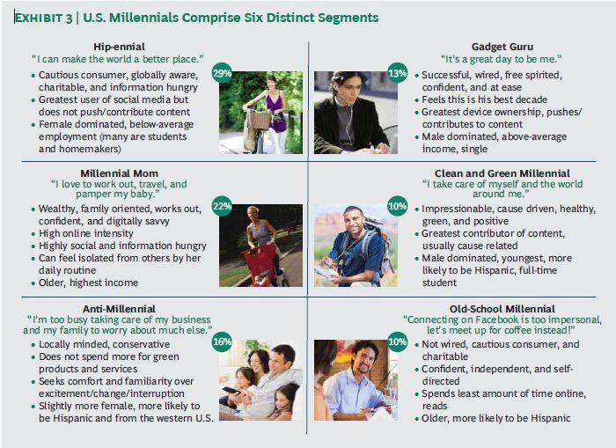
Young Professionals – By the numbers
*

Slide 8
Making the Case:
Why start a young professionals group?

Slide 9
Making the Case: Why start a YPG?
Donors between 22 and 31 years old give an average of $161 to their preferred charity and $341 total annually.
31% of donors between 22 and 31 state they want to increase their donations next year compared to only 8% of donors over 65.
Millennials, more than non-millennials, prefer to actively engage in a cause (30% vs. 22%)
68 percent of people between the ages of 18 and 26 prefer to work for a company that provides professional volunteer opportunities
YP are currently the most active "youth" segment in donating to the ARC
*

Slide 10
Examples of YPGs
Dallas:
Started summer 2013, raised $35,000 in 6 months!
Created list of 1300 young professionals
Charging $75 to become a member
Chicago:
Run highly successful Annual Golf Tournament
Flirting for disaster events

Slide 11
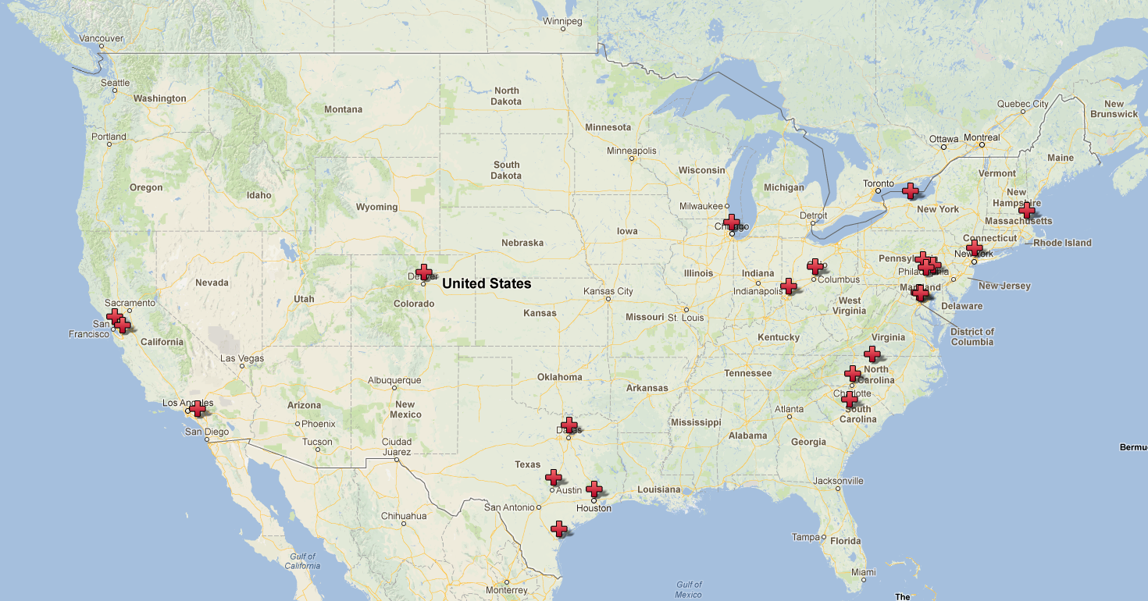
Current Young Professionals Groups
*
Notes:
*

Slide 12
Starting your Club
Steps to make your club a success

Slide 13
Starting your Club
Ideal leader
    Stable
    Driven
    Connected
    Passionate
    Motivating
    Strategic
Who would be a poor choice?
*

Slide 14
Starting your Club
Staff Needs
  Development
  Volunteer Coordinator
  Marketing
  Blood Services
Why these people and who else might be helpful?
*

Slide 15
Starting your Group
Board involvement is vital to starting your group, here is how they can help:
Provide valuable feedback on the strategic plan and direction
Facilitate introductions into the local community that might otherwise be inaccessible
Attend meetings as a guest speaker for recruitment or training
Co-host and support group events
Adds a layer of credibility to the new group
*

Slide 16
Starting your Club
Choosing a name
Silicon Valley Club Red
Young Professionals Auxiliary
Club Red of _____
Boston Young Professional Society
Friends of the Red Cross
*

Slide 17
Starting your Club
Key steps in starting
Recruit initial leader
Form small leadership group
Approach Board with initial idea
Start Facebook page/visibility on chapter website
Decide upon basics - fundraising? service? dues?
6 month calendar of events
EXECUTE!
*
Notes:
2. focus on building the list and people who can plan events
3. create immediate credibility, maybe also add Linkedin
7. You are fulfilling a brand promise, you must execute.

Slide 18
Be Creative!
Young Professional Groups thrive because of social interaction and creativity.
Singles CPR - Training
Resume Readers - Recruitment
Mini Golf Tournament - Fundraising

Slide 19
Resources

Slide 20
Resources
http://redcrossyouth.org/youngprofessionals/young-professionals-resources/
National Young Professionals Call
  First Tuesday of each month!
NHQ – Amy Daly and Portia Obeng
Young Professionals Newsletter
*

Slide 21
Questions

